Slide 1
Focus + Context
Why is it effective?
Notes:
Essentially, with focus+context views we’re able to show and overview of our data and details at the same time.
A natural question to ask next is, why is this approach so effective? Why are we doing an entire lecture on it?

Slide 2
Focus + Context
Why is it effective? → Peripheral Vision
https://en.wikipedia.org/wiki/Peripheral_vision
Notes:
The reason this design approach works so well, if because it leverages a feature of human vision: the fact that we see one thing in focus and other things in our periphery.
In other words, human vision specializes in focusing intently on one thing in the field of view, while maintaining have an awareness of everything else in the field of view.
We tend to see one thing very clearly, whatever we are focusing on, and everything else almost melts into the background. We know it’s still there, but we can’t make out specific details.
<next>

Slide 3

Focus + Context
Why is it effective?
http://www.svi.cps.utexas.edu/examples.shtml
Notes:
For example, this animation shows an example of how you might focus on the bee or the flowers in this image, and when you focus on either, you lose details about the other.
This is similar to how when you’re reading, you are focused on the exact sentence of word you’re actively reading. You’re aware that there are other words on the page, and probable aware of where you are on the page, but you can’t see all of the text in detail at once.

Slide 4
Focus + Context
Why is it effective?
Leverages our understanding of human visual focus
Aggregate information outside of the user’s focus, which would have melted into the periphery anyway
Ware, VTFD
Notes:
Focus+Context designs say, okay, we know humans cannot see everything we show in one visualization in detail at once.
However, they can intently focus on a small area of the visualization, and use the what’s in the periphery to gather context or an overview.
So with a Context+Focus design we create a focus region that is small enough for humans to view and ingest all at once, and aggregate information outside of that region to show context or background.
<next>

Slide 5
Focus + Context
How?
Ware, VTFD
Notes:
Okay, so that explain why Focus+Context is so effective.
The next natural question is “how” do we actually create these designs.
<next>

Slide 6
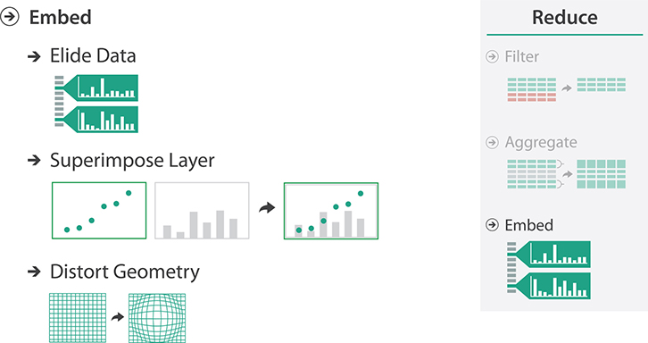
Focus + Context
How?
Ware, VTFD
Notes:
Tamara present’s three common techniques for Focus+Context designs:
Eliding
Superimposing
And Distorting.
Let’s look at each.

Slide 7
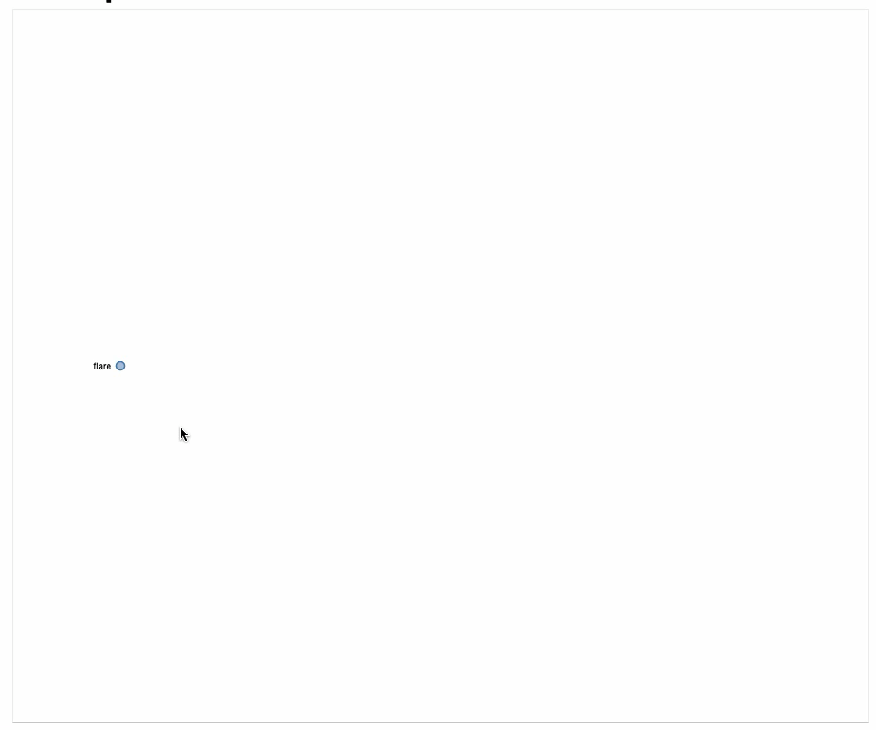
Focus + Context
How?
http://bl.ocks.org/mbostock/4339083
Munzner’s Book
Notes:
Here’s an example of Elision in actions.

Slide 8
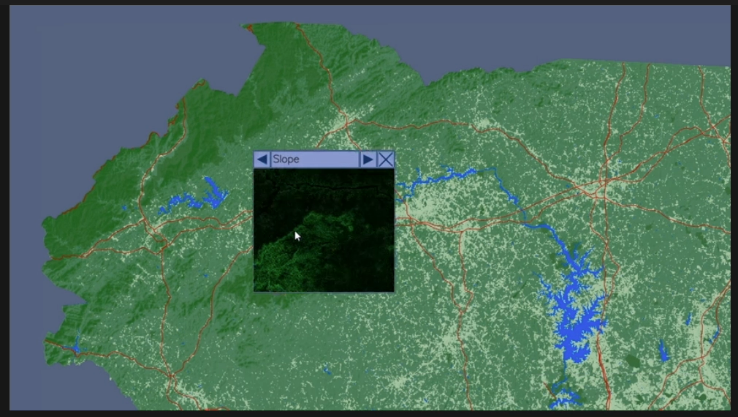
Focus + Context
How?
Magic Lens
https://www.youtube.com/watch?v=u1Pq_o67wvI
Munzner’s Book
Notes:
Let’s start with superimpose, which we’ve discussed before with respect to faceting.
Superimposing for a focus + context setting amounts to layering your data facets, but only showing those layers in detail within the focus area.
The magic lens we looked at earlier is an example of this.

Slide 9
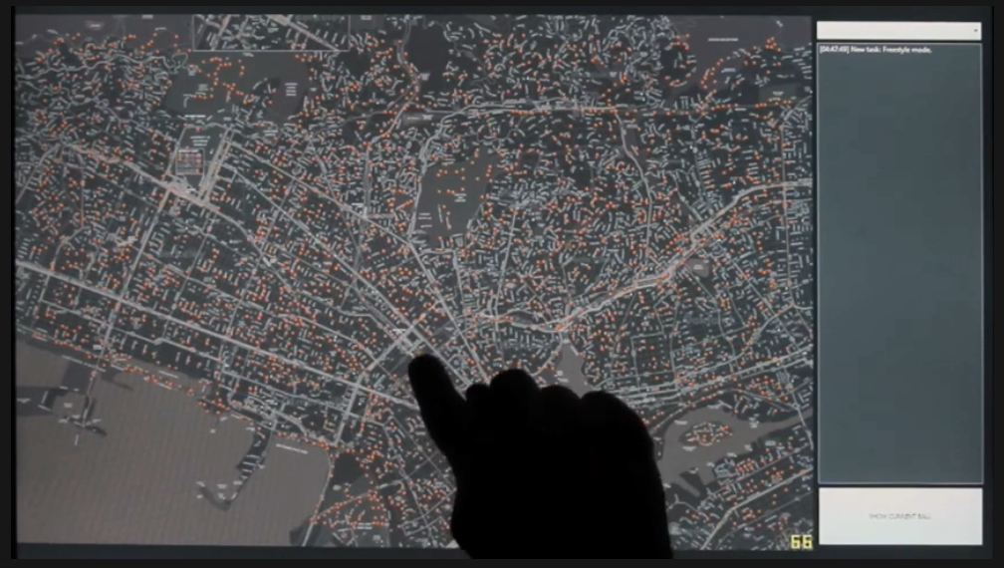
Focus + Context
How?
FingerGlass
https://www.youtube.com/watch?v=TzfXNlJtxFg
Munzner’s Book
Notes:
The second technique for embedding data is distort.
This is similar to superimpose, however the focus area of the visualization is distorted compared to the overview.
For example, this visualization allows the user to choose a focus area, and then they are shown that area through a zoomed in window.
That zooming distorts the perspective of the focus compared to the perspective of the overview.
<next>

Slide 10
Focus + Context
How?
Fisheye Lens
Leung & Apperley, 1994
Notes:
Notably, there are multiple ways to distort within the focus area.
In the past, a common approach was to use something called a fisheye lens, which uses gradiated magnification within the focus area
Similar to a fisheye lens for a camera.

Slide 11
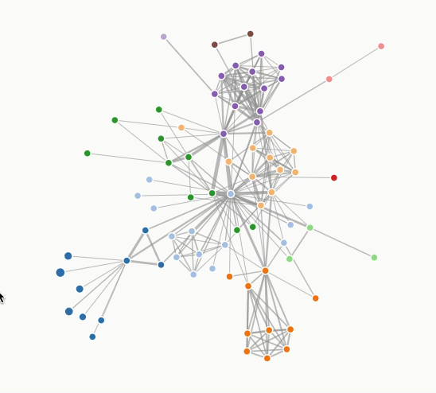
Focus + Context
How?
Fisheye Lens
http://www.cs.umd.edu/class/fall2002/cmsc838s/tichi/fisheye.html
https://bost.ocks.org/mike/fisheye/
Notes:
Here are a few examples of FishEye Lens distortions.
As you can see in these examples, the FishEye Lens’s creates a zoom that accentuates points in the middle of the focus area most and points on the edges of the focus area less.

Slide 12
Summary
Today we:
Reviewed Filtering and Aggregation
Reviewed Focus+Context Designs
ic-12 is DUE today.
pm-03 is OUT today.

